Slide 1
MOBILE PHONE SALES ANALYSIS
A Business Intelligence for Velocity Phone Inc.
By: Balogun Segun
Date: May 2026

Slide 2
Project Overview
This project analyzed 366 mobile phone sales transactions for Velocity Phone Inc. in 2024. After cleaning, 303 valid records were used to build two interactive dashboards. The analysis focused on sales performance, customer insights, and product performance to deliver data-driven business recommendations.

Slide 3
Problem Statement
Velocity Phone Inc. needed to transform raw transactional data into actionable business intelligence to optimize inventory, improve marketing strategies and drive overall business performance.
This project addresses this challenge by developing two interactive dashboards to identify sales patterns, reveal performance gaps, and provide actionable recommendations.

Slide 4
Project Objectives
The main objectives of this project are:
  Analyze overall sales performance
  Identify top-performing products
  Evaluate customer demographics
  Identify key business trends and insights
  Provide strategic business recommendations

Slide 5
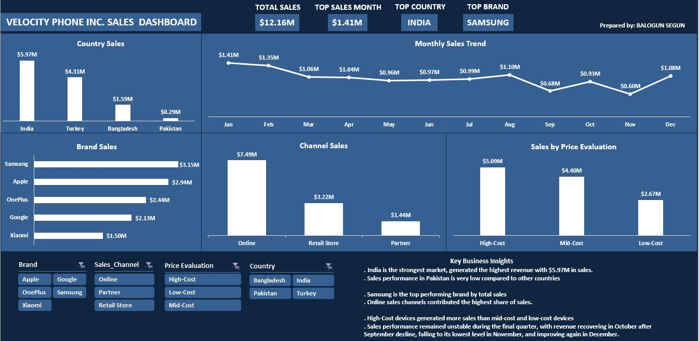
Dashboard 1 Overview
(Sales Performance Dashboard

Slide 6
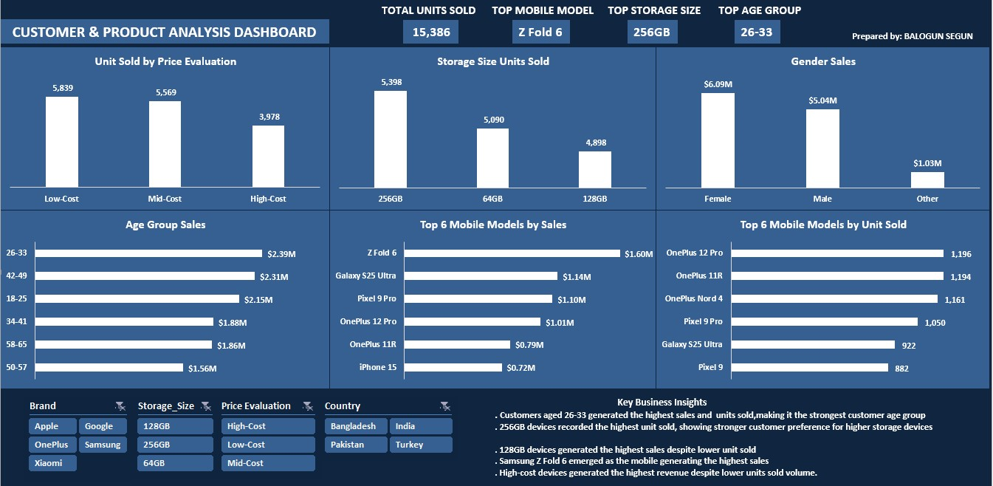
Dashboard 2 Overview

Slide 7
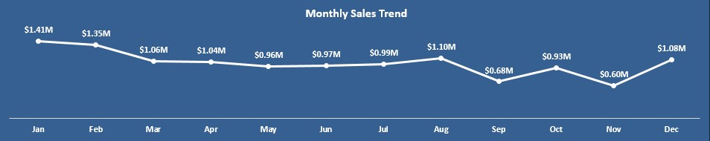
Insight
Sales varied across months, with stronger performance recorded in the earlier months, indicating uneven revenue distribution throughout the year.

Slide 8
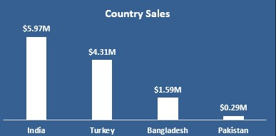
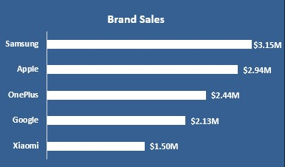
Insight
The strong performance in India and Turkey indicates higher customer acceptance and stronger market penetration in these regions.
Insight
Samsung and Apple emerged as the high-performing brands. The $1.65M gap between the top and bottom brands shows tiered market positioning, with premium brands capturing higher revenue share.

Slide 9
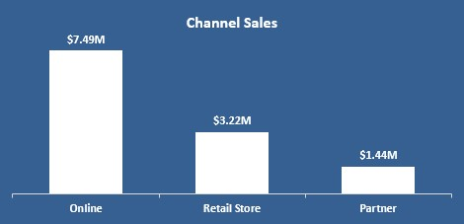
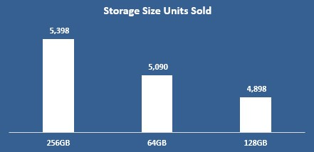
Insight
Online sales dominate customer purchasing behavior, this highlights a strong customer preference for digital purchasing channels. Retail stores remain significant, showing some customers still value physical purchase.
Insight
This indicates strong customer preference for larger storage capacities, reflecting increased demand for devices that support heavier application usage and media storage.

Slide 10
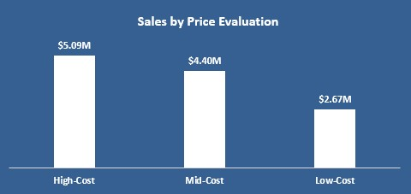
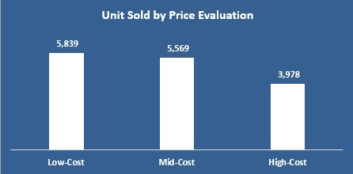
Insight
This shows that customers are willing to spend more on premium smartphones, reflecting strong demand for advanced features and high-end device specifications.
Insight
Although premium smartphones generate more revenue, affordability remains a major factor influencing purchase decisions for a larger portion of customers.

Slide 11
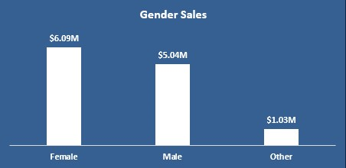
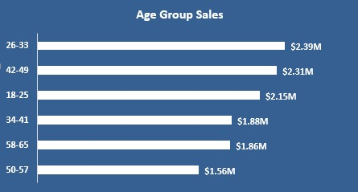
Insight
Female customers generated the highest total sales, exceeding male and “other” customer gender.
Insight
Customer aged 26-33 represent the company’s most valuable customer age-group.

Slide 12
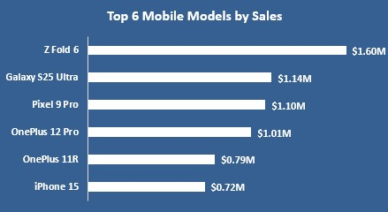
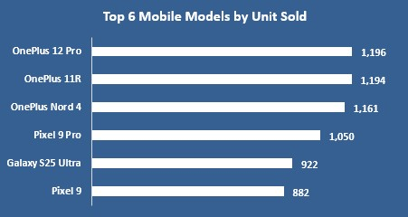
Insight
Samsung’s premium models dominate revenue generation, indicating strong market demand for high-end devices.
Insight
This suggests that customers strongly value products that balance performance and affordability. While premium devices generate higher revenue, affordably priced models achieve higher purchase volume.

Slide 13
Recommendations
Strengthen focus on high-performing markets
Optimize inventory based on product demand
Increase investment in online sales channels
Develop pricing strategies for different customer segments
Target marketing toward key customer demographics
Expand mid-range product offerings with larger storage
Improve Monthly Sales Stability
Overall, Velocity Phone Inc. should maintain a balanced product strategy that supports both premium high-revenue devices and lower-cost high-volume products. This dual approach will ensure broader market coverage and greater revenue stability.

Slide 14
Conclusion
The dashboard analysis demonstrates that Velocity Phone Inc. has significant growth opportunities.
By implementing strategic inventory planning, expanding digital channels, adopting customer-focused marketing, and driving product innovation, the company can enhance operational efficiency, increase customer satisfaction, and achieve sustainable revenue growth.

Slide 15
Thank You!

